Slide 1

Crystal Engineering
Πετράτος Γιώργος
ΑΜ: 940
8/5/2017

Slide 2
Why molecules?
The molecule is paramount in chemistry
Assemblies of molecules. How do molecules associate with each other. In specific ways?
Crystal engineering teaches us how to bring molecules together exactly as we want.
A crystal is a very precise and specific type of molecular assembly

Slide 3
Crystal
A solid form of a substance with a definite and periodic internal structure.
an external shape made up of symmetrically arranged plane surfaces.
gives a discrete X-ray diffraction pattern.
atoms, ions or molecules are in some degree of order.
a manifestation of mutual recognition.
enthalpic factors gain over entropy.
Crystal structure
The arrangement of atoms, molecules, or ions that constitutes the internal structure of a crystal.
Crystal Engineering
The understanding of intermolecular interactions in the context of crystal packing and the utilization of such understanding in the design of new solids with desired physical and chemical properties.

Slide 4
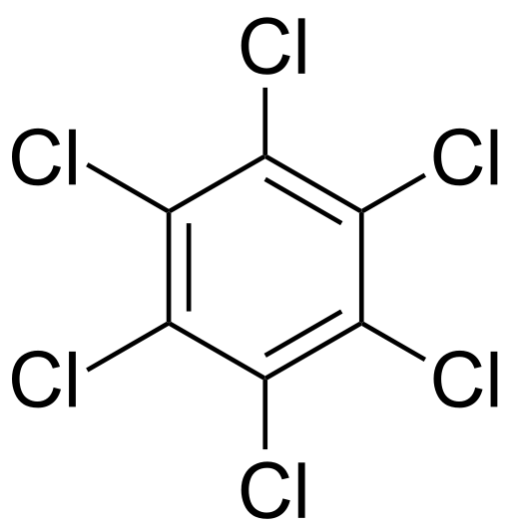
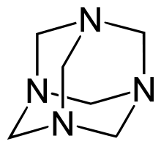
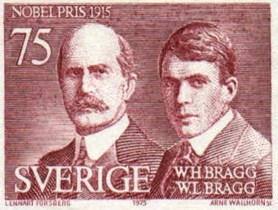
X-ray crystallography
Visualization of a crystal as a periodic array
Hexachlorobenzene and Urotropin were the earliest organic crystal structures to be determined
One of the fundamental questions of crystal engineering is
Given the molecular structure of a compound, what is its crystal structure?

Slide 5
The crystal as a supramolecular entity
Supramolecular chemistry
The chemistry of molecular assemblies, intermolecular bonds, non-covalent interactions and hydrogen bonds.
signifies that which is beyond the molecule
concerned with strategies for the controlled organization of multiple components into complex matter
In the context of crystal engineering, crystals are ordered supramolecular systems, and crystallization is an impressive display of periodic molecular assembly.

Slide 6
How are crystals stabilized?
The crystal structure of a molecule
Free energy minimum that results from a balance of attractive and repulsive forces.
Intermolecular interactions in molecules are of two types
Isotropic interactions – short range
Anisotropic interactions – long range
Electrostatic interactions
ionic interactions (salts)
Strong and weak hydrogen bonds
(O–H···O, C–H···O)
Interactions between heteroatoms
(halogen···halogen)

Slide 7
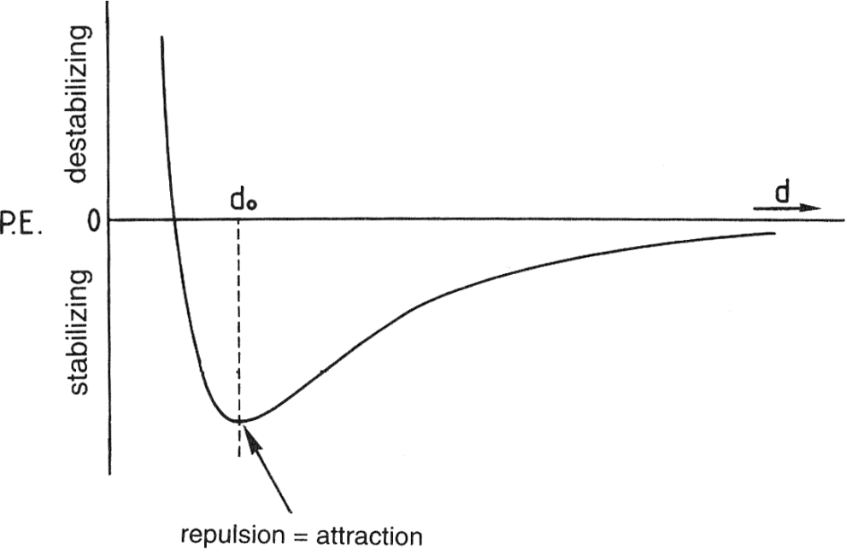
Intermolecular Interactions
Interactions and forces
Force constant
Intermolecular interactions are required for Crystal Engineering
Potential energy diagram for an intermolecular interaction
Intermolecular interactions occur in the energy range of 4–80 kJ mol⁻¹

Slide 8
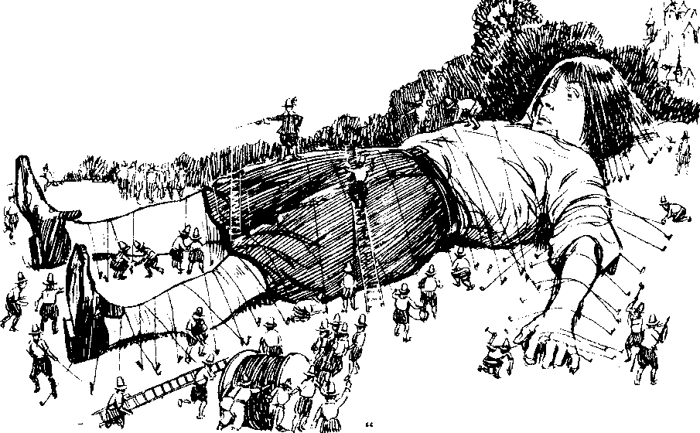
General Properties of Interactions
Strength
Weak and Strong
Directionality
Isotropic and anisotropic
Distance dependence
Electrostatic and dispersive
The design of crystal structures requires a correct assessment of the energetic and spatial properties of the intermolecular interactions in it.

Slide 9
van der Waals interactions
Lennard-Jones expression for the potential energy of a system of two non-bonded atoms i and j
U_{ij} = –Ar_{ij}^{–6} + Br_{ij}^{–12} + q₁q₂r^{–1}
U_{ij}: the potential energy between the atoms
A and B are constants
q₁ and q₂ are charges on the two atoms
First term: is dispersive (attraction)
Second term: arises from repulsive forces
Third term: empirical representation of electrostatic interactions.

Slide 10
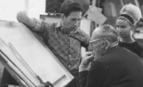
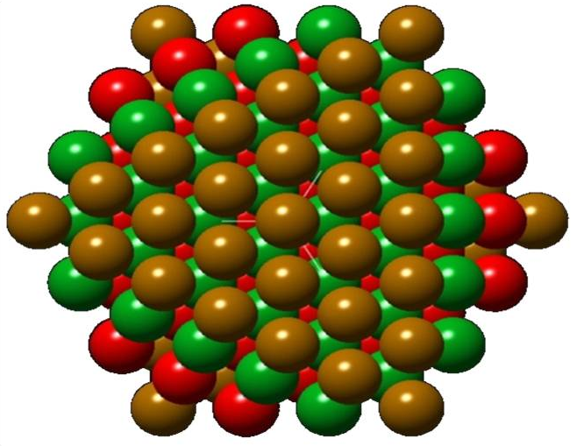
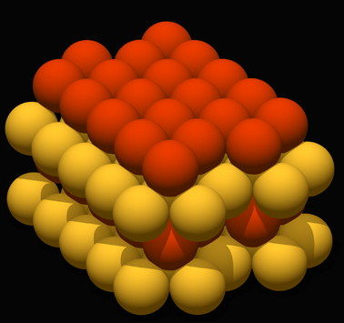
Close packing
A. I. Kitaigorodskii
The close packing principle states that molecules pack in a crystal so that any molecule is surrounded by a maximum number of close neighbors, generally 12.
cubic close packing (ccp)
hexagonal close packing
(hcp)

Slide 11
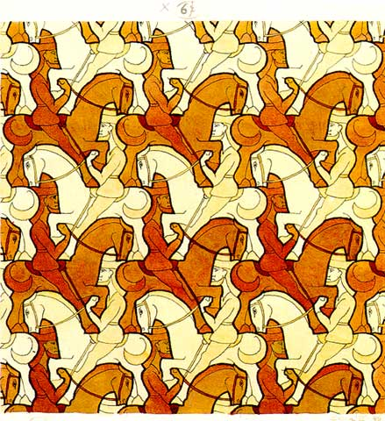
Kitaigorodskii model of close-packing
Molecules in a crystal tend to assume equilibrium positions so that the potential energy of the system is minimized.
Attractive and repulsive forces between molecules are assumed to be isotropic.
Molecules tend to approach each other so that the number of lowest energy interactions is as large as possible.
The number of intermolecular contacts in a crystal tends to a maximum and these contact distances cluster around distances associated with energy minima.
M.C. Escher's “Horsemen”

Slide 12
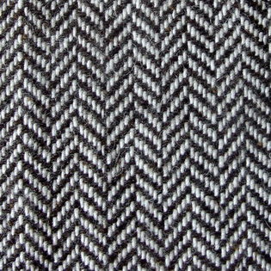
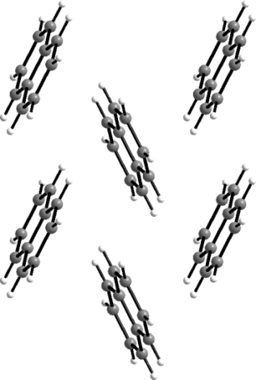
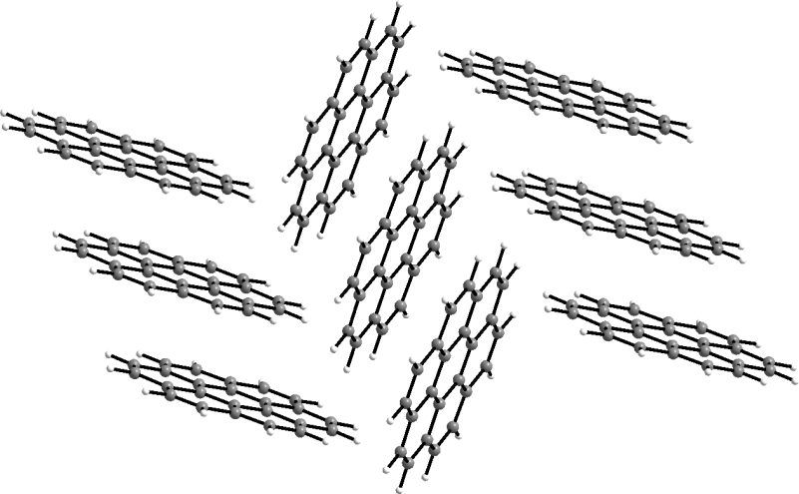
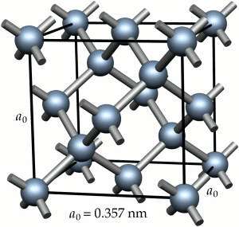
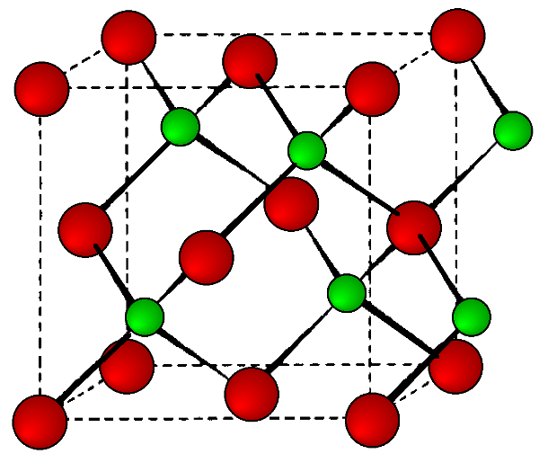
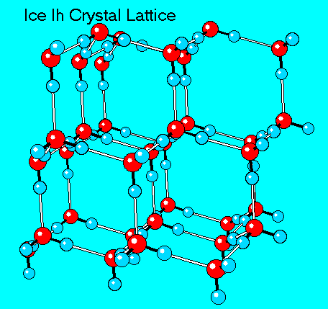
In close-packed structures, the coordination number strives to a maximum of 12
In directional structures, the coordination number can be as low as 4

Slide 13
Directional Interactions
When heteroatoms are present in the molecule,
there is the possibility of the formation of anisotropic
interactions
Deviations occur from pure close-packing
The most important
anisotropic interaction in organic crystals is
hydrogen bonding.

Slide 14
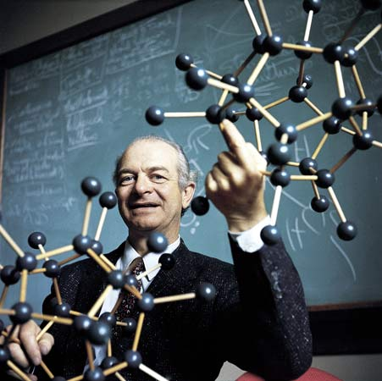
Hydrogen bond
“Under certain conditions an atom of hydrogen is attracted by rather strong forces to two atoms instead of only one, so that it may be considered to be acting as a bond between them” Linus Pauling (1939)
An attractive interaction X−H...Y−Z between a hydrogen atom from a molecule or a molecular fragment X−H in which X is more electronegative than H, and an atom or a group of atoms in the same or a different molecule, in which there is evidence of bond formation. Current IUPAC definition (2010)
(i) The hydrogen bond arises from attraction
(ii) H is more electropositive than X, the atom to which it is covalently bonded
(iii) Evidence of bond formation is needed

Slide 15
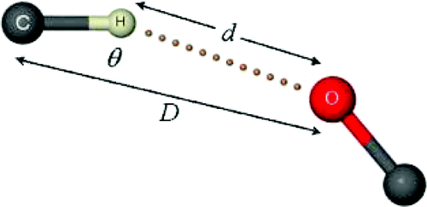
Hydrogen Bond, X–H...Y–Z
Strength | Examples | X…Y (D, Å) | H…Y (d, Å) | X–H…Y (θ,º)
very strong X−H ~ H…Y | [F−H−F]⁻ | 2.2–2.5 | 1.2–1.5 | 175–180
strong X−H < H…Y | O−H…O–H O−H…N–H N–H…O=C N−H…O–H N−H…N–H | 2.6–3.0 2.6–3.0 2.8–3.0 2.7–3.1 2.8–3.1 | 1.6–2.2 1.7–2.3 1.8–2.3 1.9–2.3 2.0–2.5 | 145–180 140–180 150–180 150–180 135–180
weak X−H << H…Y | C−H…O | 3.0–4.0 | 2.0–3.0 | 110–180

Slide 16
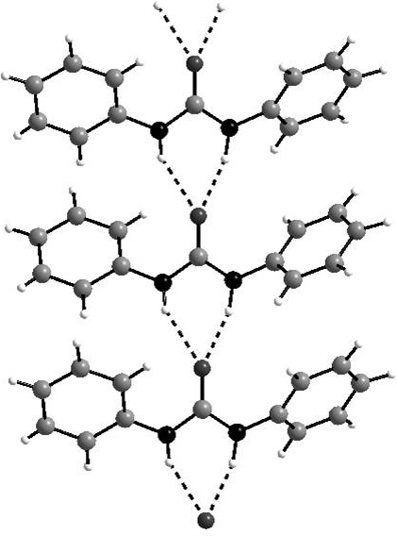
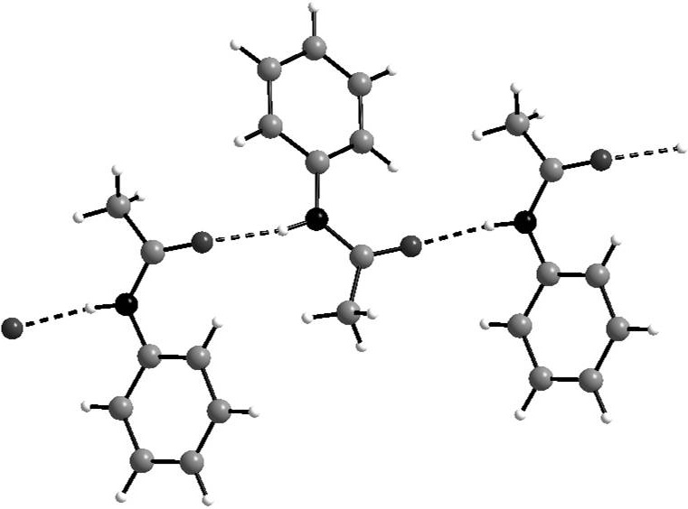
Angular properties of hydrogen bonds
Linear N−H…O=C bonds
connect secondary amide molecules in a one-dimensional array
A bifurcated hydrogen bond, or three-centered interaction in urea.

Slide 17
Weak Hydrogen Bond
X–H···Y–Z in which the electronegativities of the
donor and acceptor atoms X and Y are reduced
Properties
Compressed or expanded and bent or straightened by
other crystal packing forces.
Less discernible are the associated directional
characteristics
These interactions can play a significant role in crystal packing

Slide 18
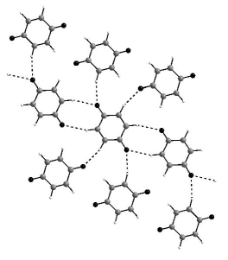
C–H…O Hydrogen bonds in 1,4-benzoquinone

Slide 19
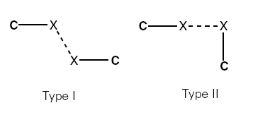
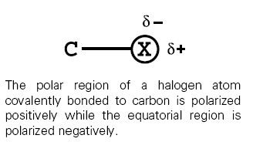
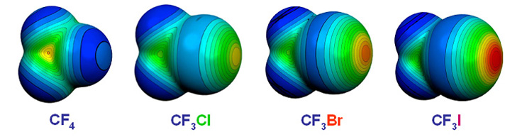
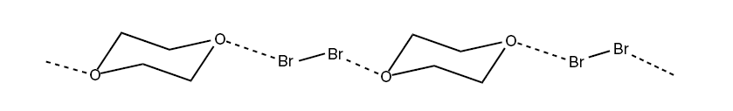
Halogen bonds
Type-I
Type-II
1:1 molecular complex of bromine and dioxane assembled with polarization induced Br^{δ+}···O^{δ–} interactions. Odd Hassel (1960s)

Slide 20
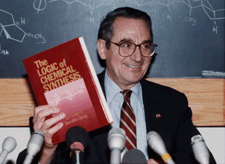
Synthon
E. J. Corey (1960s)
The smaller sub-structural units that are generated by
disconnecting the targets.
The synthon is small but representative of the target.
It contains those combinations of bonds in the target that
can be made through known reactions.

Slide 21
Supramolecular synthon
Supramolecular synthons are structural units within supermolecules which can be formed and/or assembled by known or conceivable synthetic operations involving intermolecular interactions.
A supramolecular synthon is a pattern that is composed of molecular and supramolecular elements.
When crystal patterns repeat regularly, the pattern of interactions can be called a supramolecular synthon.

Slide 22
Synthons in crystal engineering

Slide 23
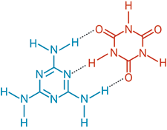

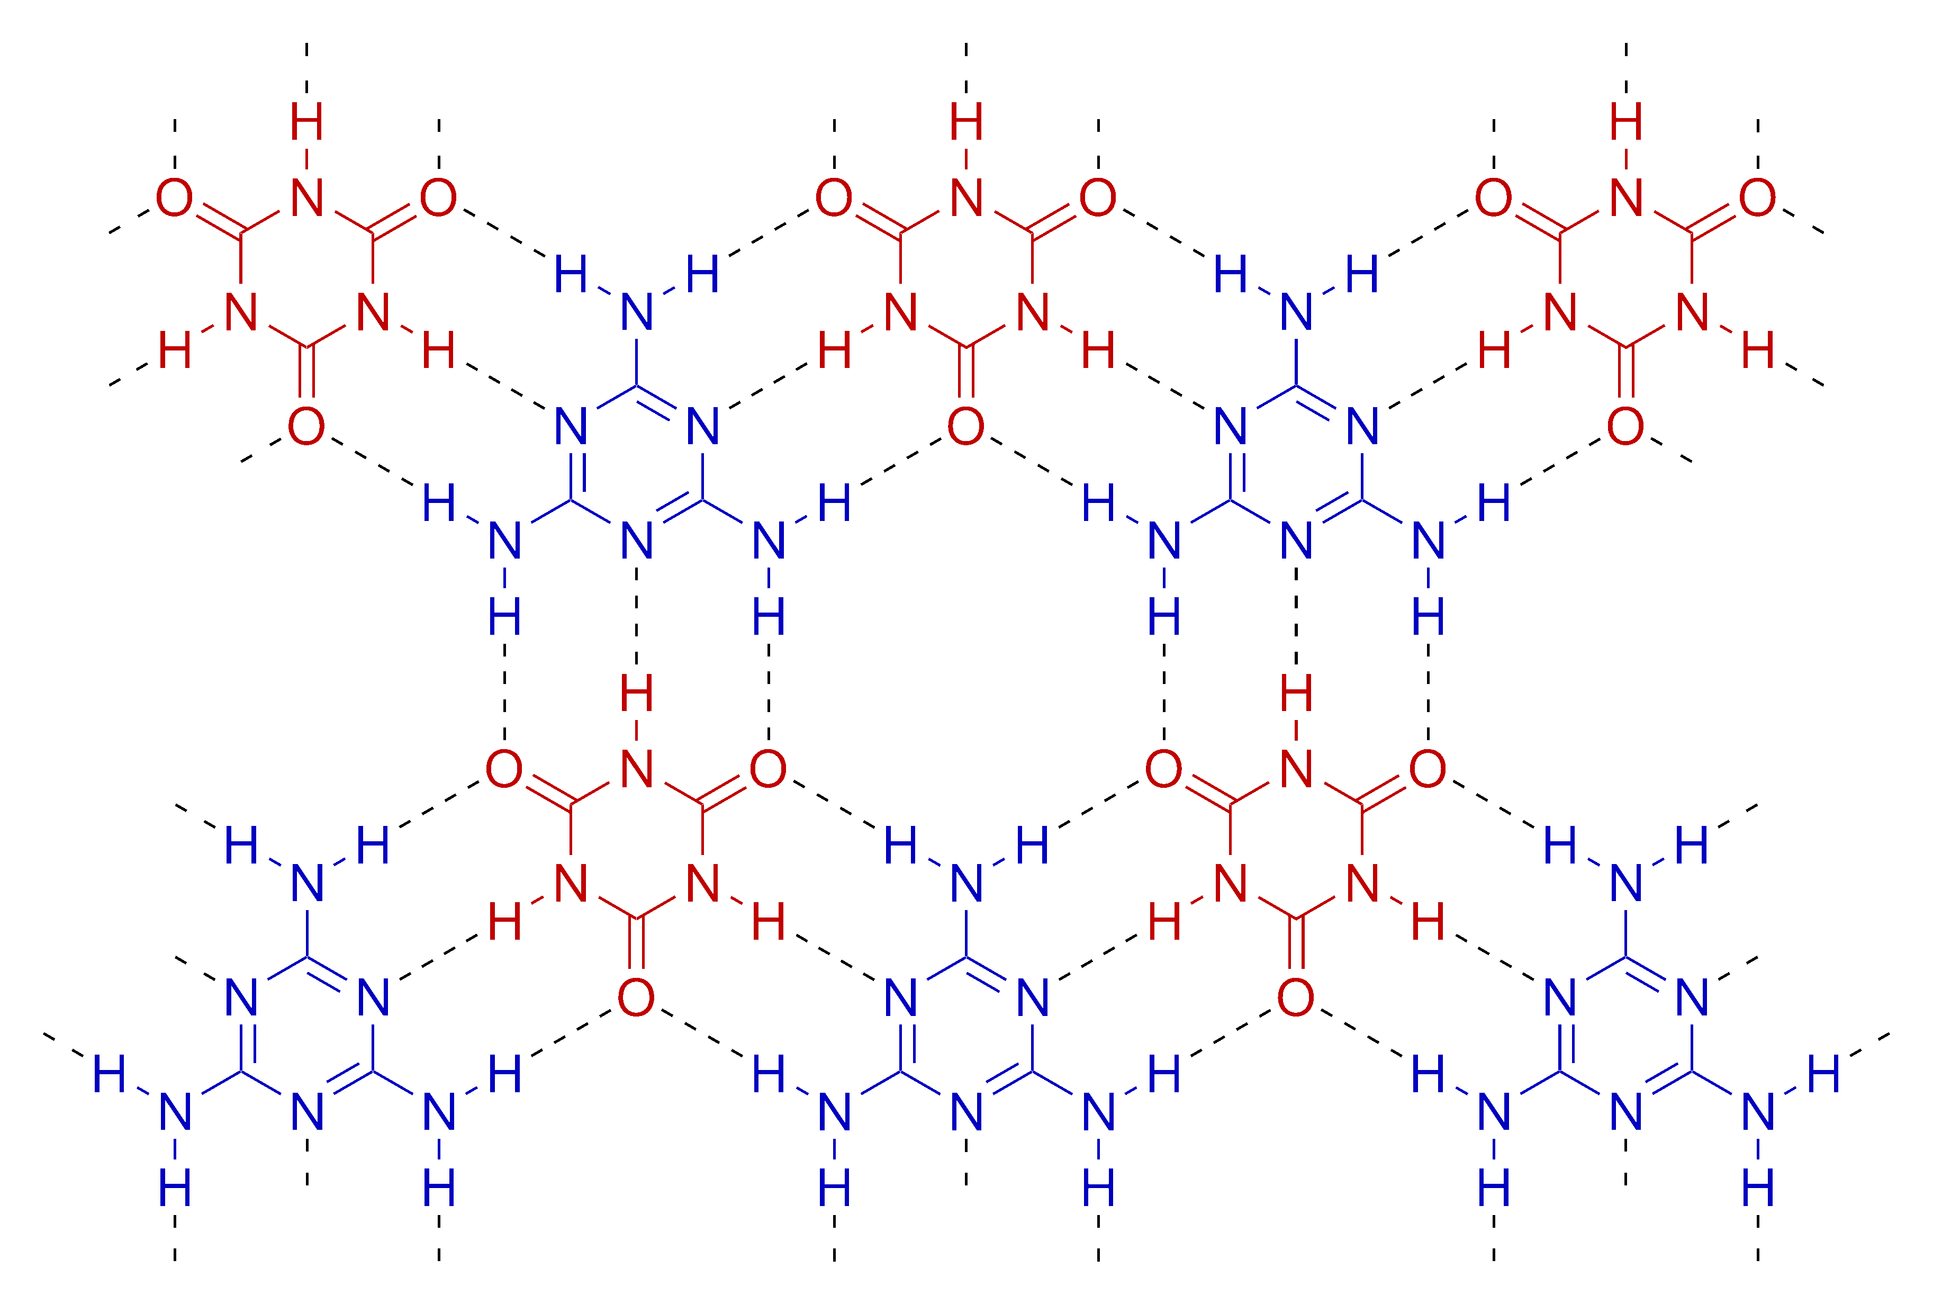
Synthons in crystal engineering
Rosette

Slide 24
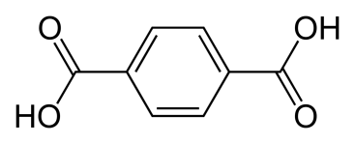
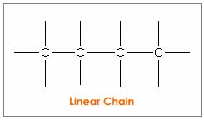
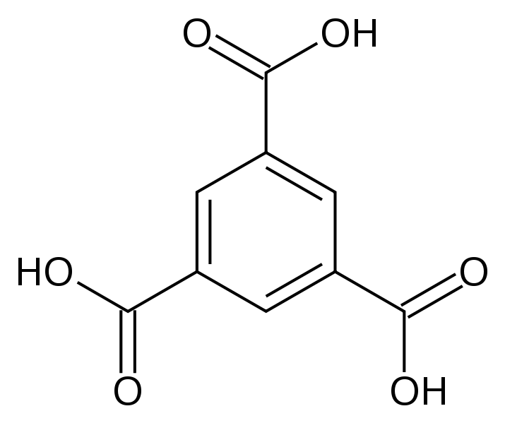
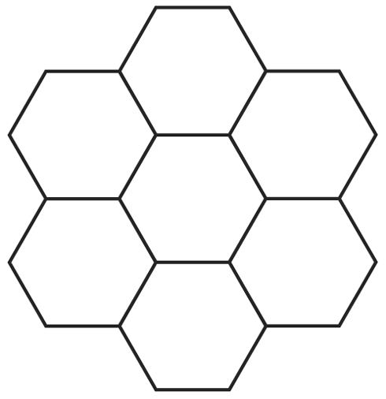
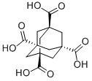
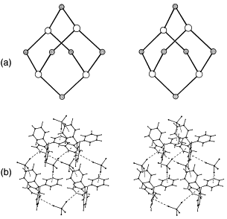
Building up dimensionality
1D
Nodes
and
Connectors
2D
Molecules – Nodes
Synthons – Connectors
3D

Slide 25
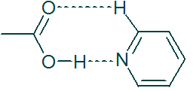
Dimer vs Catemer
Only a third of all carboxylic acids form carboxyl dimers
Catemers are not as common as dimers
Homosynthon vs Heterosynthon

Slide 26
Synthons in crystal engineering
Theoretically, the number of supramolecular synthons in a crystal structure is very large.
A synthon is more useful if it occurs more frequently
in a given group of compounds.
A synthon is more useful if its formation is more specific.
A synthon is more useful if it can lead to meaningful
fragments in its disconnection.
The best synthons combine an economy in size with a surfeit of structural information.

Slide 27
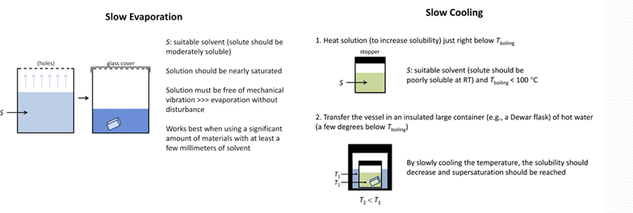

Slide 28
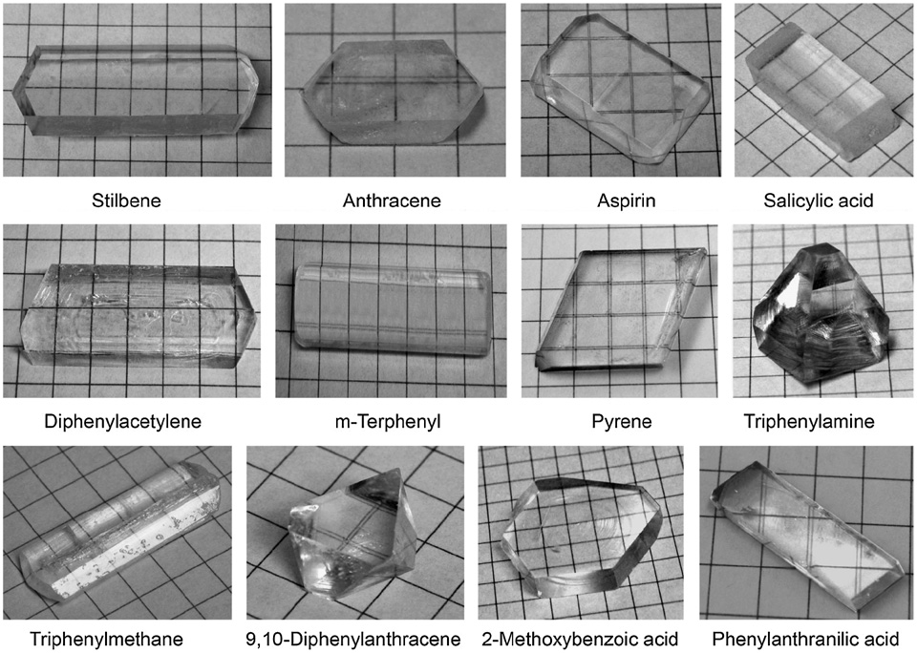
Solvent evaporation is a common technique employed to grow large single crystals of organic solids.

Slide 29
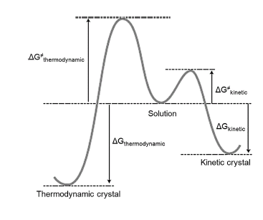
Thermodynamics and kinetics of
crystallization
Thermodynamic crystal – The crystal with the lowest free energy in any particular system. It is at the global minimum of the structural landscape of the compound.
Kinetic crystal – Metastable crystal formed because of some favorable aggregation pattern of molecules

Slide 30
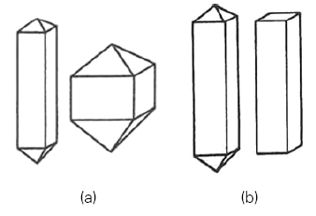
Crystal Morphology and Habit
Both morphology and habit refer to descriptions of the external form of a crystal.
Crystal morphology refers to the faces of a crystal and the interfacial angles.
(a) Same morphology but different
habits. The relative dimensions of the crystals vary.
(b) Different morphologies but similar habits. The crystal faces are different but the relative dimensions are similar.

Slide 31
Polymorphism
It is the phenomenon in which the same chemical substance exhibits different internal crystal packing arrangements.
Polymorphism is an exclusively solid state phenomenon.
Polymorphs have distinct :
Crystal structures (mutual arrangements of molecules, atoms or ions).
Physical and chemical properties.
Polymorphs can often have: different morphologies, solubility, colour, melting or sublimation temperatures, densities, thermal or electrical conductivities and other physical properties.

Slide 32
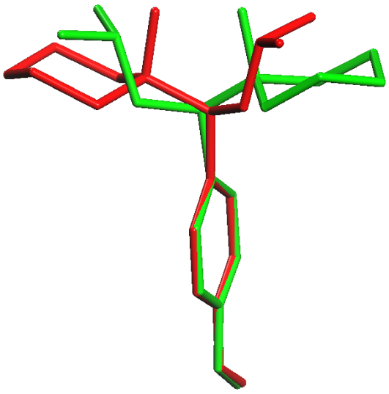
Some types of polymorphism
Venlafaxine
Conformational polymorphism
Each of the isolated crystal forms contains a different conformation of the same molecule
Tautomeric polymorphism
Crystal forms of tautomers are often considered to be polymorphs, because the tautomers generally equilibrate in solution at the temperature at which the solid forms are isolated.
Omeprazole

Slide 33
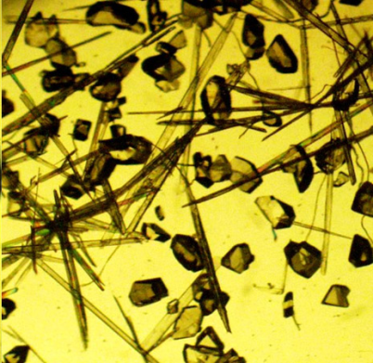
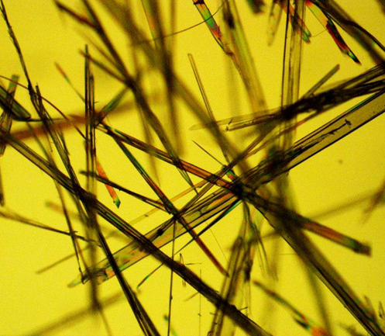
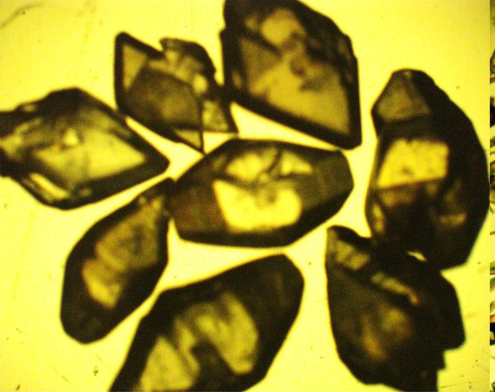
Some interesting phenomena
Concomitant polymorphs
3-acetylcoumarin
Concomitant mixture of
Forms A and B
1:1 CHCl₃:n-hexane
at 278 K
(Form A)
1:1 CHCl₃:n-hexane
at 296K
Form B
glacial acetic acid
at 296K
Disappearing polymorphs
Crystal forms that fail to reappear after their initial isolation.
Pseudopolymorphs
Crystal forms in which an organic molecule is associated with differing amounts of solvent, say water
M.H₂O M.(H₂O)_{0.5} M.(H₂O)_{1.5} M.(H₂O)₂

Slide 34
Thermodynamic versus Kinetic factors
When a compound exists in various solid state forms or polymorphs, two major issues need to be addressed:
(i) The relative stabilities and the transformations that can occur between the forms.
(ii) The time needed for the transformations to reach equilibrium.
Thermodynamics provides information about the first aspect (how far) and kinetics about the second (how fast).

Slide 35
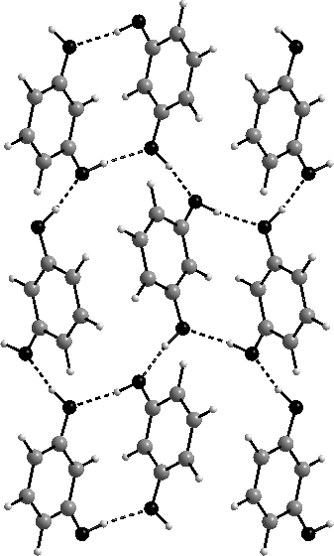
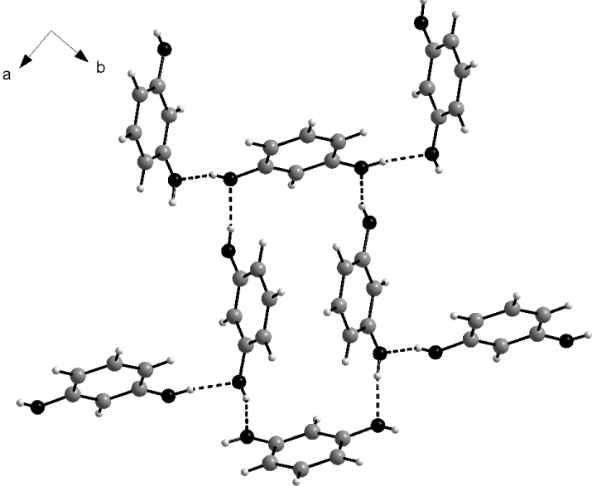
Polymorphism and Intermolecular Interactions
The same functional group and the same synthons but differences in the overall packing.
Resorcinol

Slide 36
Polymorphism and Intermolecular Interactions
The same functional group and the same synthons but the multiple occurrences of these groups in different and distinctive molecular locations
Pyrazinamide

Slide 37
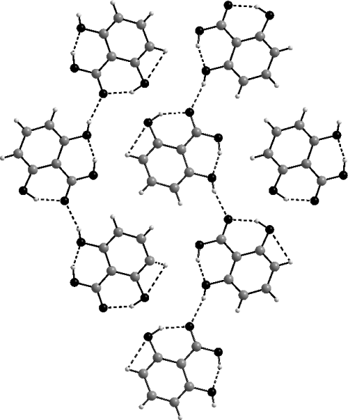
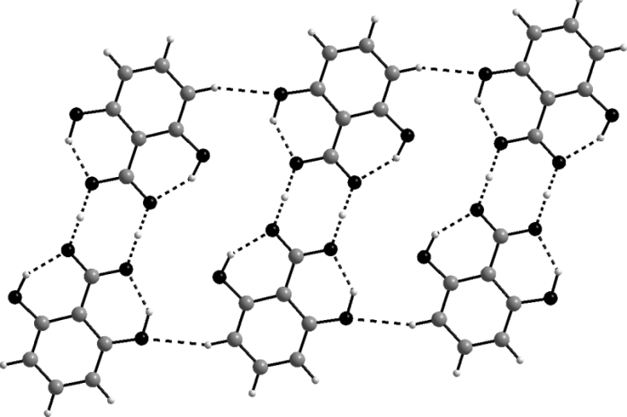
Polymorphism and Intermolecular Interactions
Different synthons and different packing arrangements.
2,6-Dihydroxybenzoic acid

Slide 38
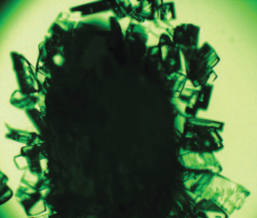
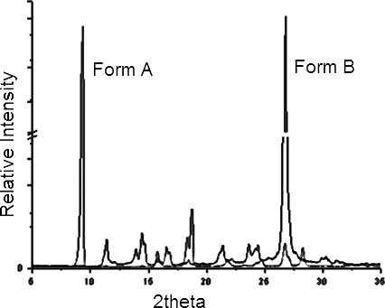
Methods of Polymorph Characterization
Hot Stage Microscopy
Sample is viewed using some form of optical microscopy while a hot stage is employed to control the temperature of the sample.
Powder X-ray Diffraction
Information obtained about:
Phases present (peak positions)
Phase concentration (peak areas) and
Amorphous content (background hump)

Slide 39
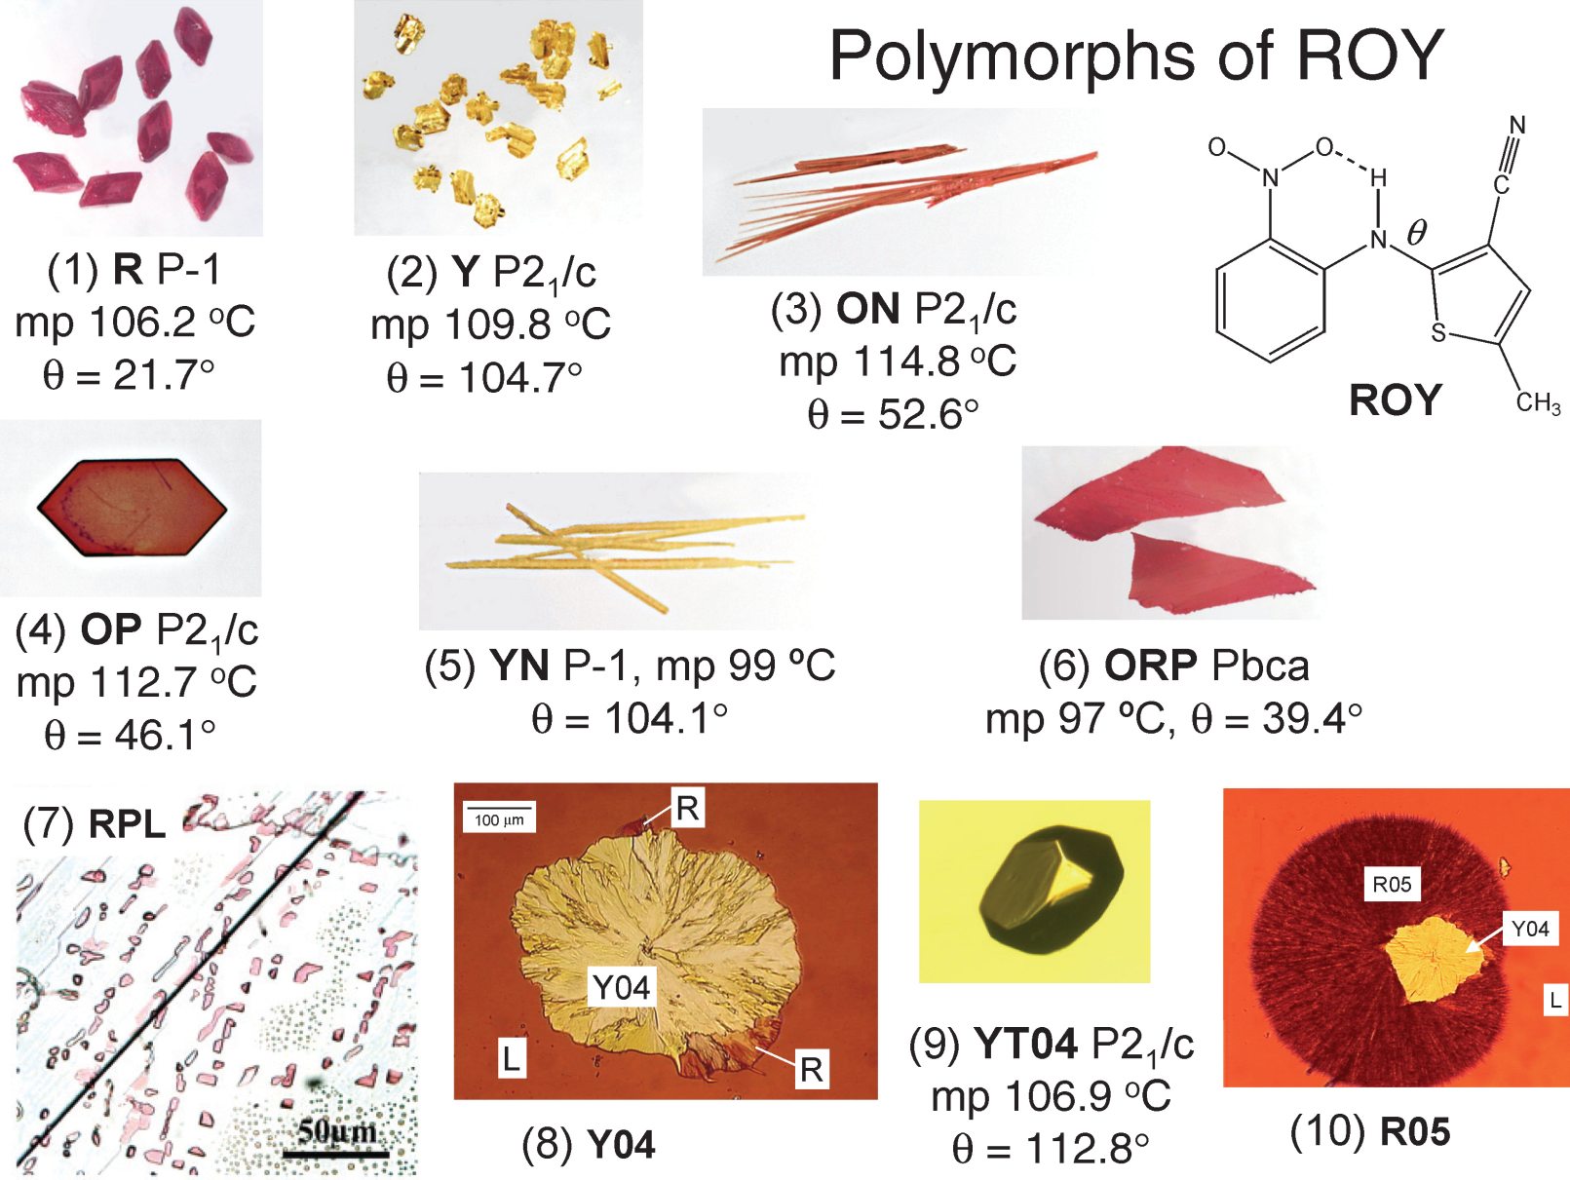
Properties of Polymorphs
Colour

Slide 40
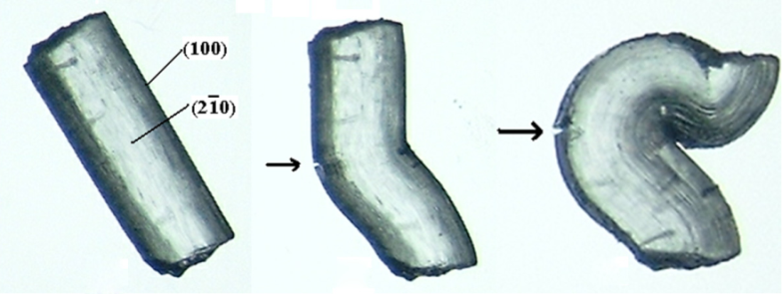


Properties of Polymorphs
Mechanical Properties

Slide 41
Polymorphism and the Pharmaceutical Industry
Formulation and Activity: Differences in crystal morphology can affect processing properties like filtering, drying, flow, tableting, rate of dissolution, shelf life and bioavailability.
Legal issue: A mixture of polymorphs is chemically pure but it is not pure in a crystallographic sense because it consists of crystals with different crystal structures.
A drug has both chemical and crystallographic properties that may be independently entitled to patent protection.

Slide 42
Multi-component crystals
All isolable crystals are free energy minima in the energy surface
Multi-component crystals A_{m}B_{n} obtained when the free energy is lower than for either pure A or pure B.
Energy of A_{m}B_{n} can be minimized because of enthalpy or entropy

Slide 43
Solid Solutions
anthracene/acridine
diphenylmercury/tolan
2-chloro/2-bromonaphthalene
4,4′-bipyridyl/biphenyl
When size and shape differences between molecules become significant, solid solution formation becomes restricted to narrower compositional ranges.

Slide 44


Host-guest compounds
Host types:
Molecular host: a single molecule which has a cavity or cleft
Supramolecular host: stabilized through non-covalent interactions
molecular host
guest
host-guest compound
molecule
supramolecular host
guest
host-guest compound

Slide 45
Donor-Acceptor Complexes
Formed between π-donors and π-acceptors.
Physical and chemical properties
Formation associated with enhancements in aromatic ring polarization.
Often associated with electrical conductivity and superconductivity

Slide 46
Donor-Acceptor Complexes
Molecular conductors: BEDT-TTF
Segregated stack
Conductor)
Molecular insulators: TCP-TTF
Mixed stack
(Insulator)

Slide 47
Co-crystals
What distinguishes a co-crystal from other categories of
multi-component solids?
Solids that are crystalline single phase materials composed of two or more different molecular and/or ionic compounds generally in a stoichiometric ratio.
4′-bromo-4-cyanobiphenyl/4′-bromo-4-cyanobenzene
methyl-1,4-dicyanobenzene/2,3,5,6-tetrafluoro-1,4-diiodobenzene

Slide 48
Co-crystals
The most common families of hydrogen bonded compounds are:
carboxylic acids
and
primary amides
Acid-acid or amide-amide homodimer synthon: Homosynthon
Acid-amide heterodimer synthon: Heterosynthon
M. J. Zaworotko: introduced the terms Homosynthon and Heterosynthon

Slide 49
Pharmaceutical Co-crystals
Pharmaceutical co-crystals and patent protection
Novelty
New composition
Non-obviousness
Identification of the co-former hardly ever routine
Utility
Better solubility, bioavailability and dissolution profile

Slide 50

Pharmaceutical Co-crystals
Co-crystal formation between two drug molecules
Co-crystal formed between the two anti-HIV drugs:
lamivudine and zidovudine
(trade name Combivir)
co-crystal may be more effective than the individual drugs in therapeutics.

Slide 51


Applications of Pharmaceutical Co-crystals
To enhance solubility
Co-crystal of itraconazole with succinic acid exhibit higher solubility than the pure drugs.
Amorphous
Itraconazole-L-malic acid
Itraconazole-L-tartaric acid
Itraconazole-succinic acid
Itraconazole crystalline

Slide 52

Applications of Pharmaceutical Co-crystals
(ii) To decrease solubility
1:1 or 1:2 caffeine-gentisic acid co-crystals are less soluble than pure caffeine
(iii) To improve stability and shelf life
Stability towards atmospheric moisture is important for processing, formulation, packaging, and storage.
Caffeine: susceptible to hydration with change in humidity. Caffeine-oxalic acid co-crystal: stable towards humidity for several weeks.

Slide 53




Applications of Pharmaceutical Co-crystals
(iv) To control mechanical properties
Mechanical properties: a function of intermolecular interactions and crystal packing.
Paracetamol
The analgesic drug is dimorphic
Form II is preferred for tableting but it is less stable than Form I
Form I
Form II
Paracetamol-theophylline co-crystal:
Stable and the layered structure resembles Form II; can be compacted easily

Slide 54
Coordination Polymers
An infinite array of coordination complexes
Metal ions are bridged by multidentate ligands (J. C. Bailar in 1964)
Metal ions + exodentate ligands (spacers or linkers)  polymer
Discrete neutral or a charged species
It is a molecular entity and zero-dimensional
From a coordination complex to a coordination polymer (R. Robson, 1990)
X is a terminal ligand or solvent

Slide 55
Coordination Polymers of different dimensionalities
one dimensional
two-dimensional
three-dimensional

Slide 56



Various forms of Coordination Polymers
Linear
Zigzag
ladder
ring/necklace
helical
Some 2-D and 3-D architectures

Slide 57
Supramolecular Isomerism
Formation of [Co(dpee)_{1.5}(NO₃)₂] (dpee = 1,2-bis (4-pyridyl)ethane) under different crystallization conditions.
MeOH/MeCN solvent mixture:
a linear chain made up of rings
MeOH/CHCl₃ solvent mixture:
a ladder-like structure
MeOH/CHCl₃ solvent mixture contaminated with ferrocene:
a bilayer structure
Same metal to ligand stoichiometry
Metal center is pentagonal bipyramidal

Slide 58
Interpenetration
The nets not directly connected.
Cannot be separated without the breaking of bonds.
Large repeating units in 2-D and 3-D nets
Create empty spaces
Filled with counter ions, solvent or guest molecules or entangled
Longer M–L–M distance: degree of interpenetration increases
Zn(CN)₂ network: two-fold interpenetration.
Adamantane-1,3,5,7-tetracarboxylic acid: 5-fold interpenetration

Slide 59
Interpenetration
Degree and nature of interpenetration
depends on:
bulkiness and conformation of the ligands
counter ions
solvents and
experimental conditions (such as dilutions)
Interpenetration in Ag(NC-(CH₂)_{n}-CN)₂BF₄
n Interpentration
1 2
2 5
4 6
8 8

Slide 60
Interpenetration
Interpenetration in 1D CPs
Interweaving of single stranded coordination polymers.
Can lead to 1-D and 2-D entangled structures.

Slide 61




Interpenetration
Interpenetration in 2D CPs
Mean planes of the nets interpenetrate either in a parallel or
an inclined fashion.
a
b
c
d
Parallel interpenetration
parallel/parallel
diagonal/diagonal and
parallel/diagonal

Slide 62

Interpenetration
Interpenetration in 3D CPs
Double interpenetration: [Zn₄O{(O₂C)₂R)₃}]
(where (O₂C)₂R = various linear dicarboxylates)
12-fold interpenetration: [Cu(SO₄)(L)(H₂O)₂]
(L = N,N'-di(4-pyridyl)adipo-amide).
54-fold Interpenetration: [Ag₃(OH)(H₂O)₂(Tipa)_{2.5}] [Mo₂O₇] 4.5H₂O (Tipa = tri(4-imidazolylphenyl)amine)

Slide 63
Porous Coordination Polymers (PCPs) or MOFs
Porosity
An important property of CPs.
Potential applications: gas and liquid storage, separation, ion exchange, heterogeneous catalysis, sensing, nanoreactors and drug delivery.
Voids, cavities and channels: determined by nature of crystal packing features of CPs.
Interpenetration reduces the pore sizes.

Slide 64
Gas Sorption and Storage
Interesting characteristics of porous MOFs
Specific surface area (1000-6000 m² g⁻¹)
versus
conventional zeolites (~500 m² g⁻¹)
Trap various gases such as H₂, CO₂ and CH₄
Importance: Energy storage, capture CO₂ emissions.

Slide 65


Postsynthetic Modifications of MOFs
Space inside the pore used as a reaction vessel
Ligands lining the pores exposed and accessible for reaction

Slide 66
Properties and Applications
Gas storage: Storage of H₂, CH₄, CO₂, C₂H₂
Magnetic: Magnetic Ordering, Spin Crossover, ferro-, ferri-, antiferro-magnetic materials
Optic: Luminescence and Sensing, Nonlinear Optical Properties, Birefringence
Electric: Proton and electron conductivity, Ferroelectricity, Multi-ferroics
Thermal: Negative Thermal Expansion
Medical: Drug release and delivery
Catalysis and Separation: To mimic zeolites

Slide 67
References
Http://onlinelibrary.wiley.com/doi/10.1002/anie.200700534/full
X-ray Structure Determination - A Practical Guide" by G. H. Stout and L. H. Jensen)
Crystal Engineering, A textbook by Gautam R Desiraju, Jagadese J Vittal , Arunachalam Ramanan
G. R. Desiraju, Angew. Chem. Int. Ed. 34, 2311–2327

Slide 68
Τhe End
Ευχαριστώ για την προσοχή σας!!

